Slide 1
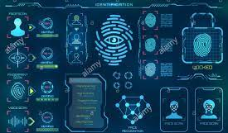
PERSON IDENTIFICATION AND VERIFICATION
Presented by:
Arnab Biswas-21EC65R01
Ritwik Das-21EC65R02
Alisha Oraon-21EC65R04

Slide 2
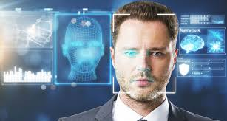
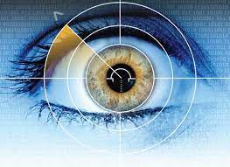
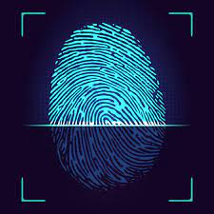
INTRODUCTION
Authentication is the primary requirement for any system by means of privacy & security.
Biometrics is the automated use of physiological or behavioral characteristics to determine or verify identity.
It is rapidly evolving technology that is being widely used in forensics, security; prevent unauthorized access in bank or ATMs, in cellular phones, smart cards, PCs, in workplaces, and computer networks.
The emerging biometric modalities include: Hand, Face, Fingerprint, Signature, Voice, Iris, Retina, DNA, Ear Pattern.

Slide 3
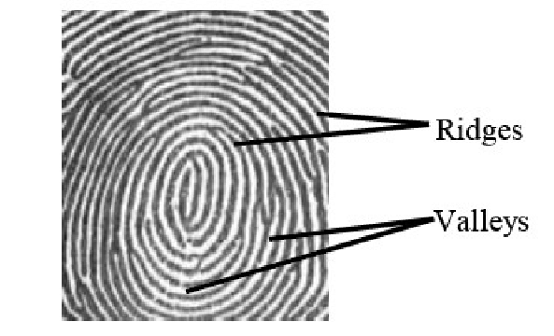
FINGERPRINT RECOGNITION
Used widely for identification.
Reasons - ease of capture, highly distinctiveness, persistence over time, fingerprint sensors are smaller and cheaper.
Fingerprint is a combination on many of ridges and many of valleys on the fingertip’s surface , ridge declared as black lines and the valleys declared as white lines .

Slide 4
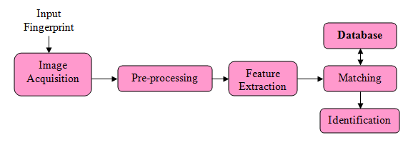
STAGES OF FINGERPRINT RECOGNITION

Slide 5
STAGES:
ACQUISITION STAGE : process to obtain image by different ways.
PRE-PROCESSING STAGE : the process of removing unwanted data in fingerprint image such as noise , reflection ,etc. It is used to increase the clarity of ridge structure. The main steps to do Pre-processing stage are enhancement fingerprint image , binarization and thinning.
FEATURE EXTRACTION STAGE: the result of pre-processing stage is passed to the feature extraction. In this stage feature of image are extracted like ridges,valleys,minutiae, singular points and etc. These features are used for verification and identification. The fingerprint recognition technique is divided to two categories :minutiae based approach, and pattern-based.

Slide 6
FEATURE EXTRACTION STAGE :
Minutiae Based Approach : Most popular and widely used technique. Minutia based techniques represent the fingerprint by its local features, like terminations and bifurcations. Two fingerprints match if their minutiae points match.
Pattern based : this algorithms compare the basic thumb impression patterns (arch, whorl, and loop) between a previously stored template and a candidate fingerprint.
Correlation Based Matching: Two impression images are superimposed and the correlation between corresponding pixels is computed for different alignments (e.g. various displacements and rotations).

Slide 7
MATCHING STAGE : The matching stage is a process to compare two fingerprints images and compute the similarity degree between them.The result will be consider as matching Score. If matching Score closer to 1 then both fingers from same user. If matching score near to Zero then both fingers from different user .
MATCHING STAGE
1:1 MATCHING
1:N MATCHING
The person has his/her identity details to be verified by comparing with authenticate records.
eg: phone match
A person’s biometric identifiers searched through entire database. eg-forensic

Slide 8
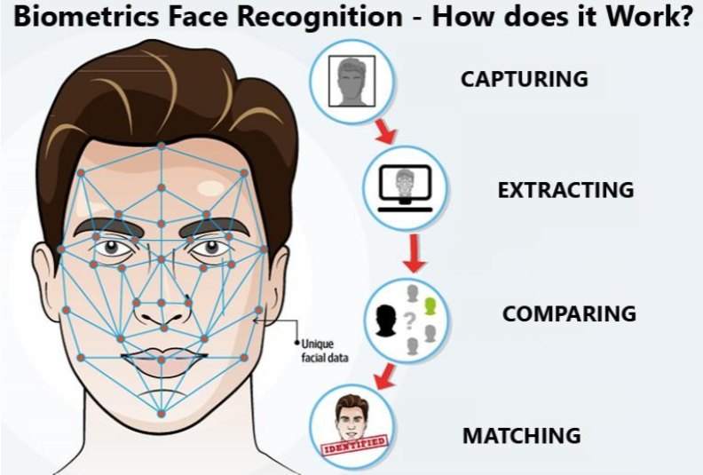
Face
Recognition

Slide 9
FACE RECOGNITION
Becomes subject of interest for many years.
In requires no physical interaction on behalf of the users.
Advanced new technology and better than fingerprint recognition.
Analysis the geometry of faces.
Accuracy is better than the fingerprint recognition technology.
Currently used in many phases in our daily life, such as entertainment, security system, smart card

Slide 10
History
In 1960, the first semi-automated system for facial recognition to locate the features (such as eyes, ears, nose and mouth) on the photographs.
In 1970, Goldstein and Harmon used 21 subjective markers like hair colour and lip thickness to automate the recognition.
In 1988, Kirby and Sirovich used standard linear algebra technique to the face recognition.

Slide 11
Facial Recognition
In the facial recognition, there are two types of comparison:
Verification: The system compares the given individual with who they said they are and gives a yes and no decision.
Identification: The system compares the given individual to all other individuals in the database and gives a ranked list of the matches.

Slide 12
The identification technology operates in four steps:
Capture: A physical sample is captured by the system during enrollment and also in identification process.
Extraction: Unique data is extracted from the sample and a template is created.
Comparison: The template is then compare with a new sample.
Match/Non-match: The system decides if the features extracted from the new samples are a match and non-match.

Slide 13
Implementation
The implementation of face recognition technology includes four steps:
Image acquisition
Image processing
Distinctive characteristics Location
Template creation
Template matching

Slide 14
Face Recognition
Local Features
Global Features
LBP
Gabor
LDA
PCA

Slide 15
LBP(Local Binary Pattern)
Defined as an ordered set of binary comparison of pixel intensities between the centre pixel and its eight surrounding pixel.
LBP operator summarize the local special structure of an image.

Slide 16



Method
We can use following formula to do the local binary method
Here, de denotes the value of the centre pixel.

Slide 17
Methodology
First the image will be divided to several blocks: each block is a matrix of type 3x3
Then, in each matrix the system will be comparing the centre pixel of the block with the other pixels.
If the centre pixel>=other pixel, we will place 1, otherwise we will place 0.
Getting the binary number of each block.
Converting to decimal number.

Slide 18
Challenges in Facial RECOGNITION:
Occlusion means blockage, and it occurs when one or other parts of the face are blocked and whole face is not available as an input image. Occlusion is considered one of the most critical challenges in face recognition system.
Facial Recognition Systems are highly sensitive to pose variations. The pose of a face varies when the head movement and viewing angle of the person changes.
Existing state-of-the-art facial recognition methods rely on ‘too-deep’ Convolutional Neural Network (CNN) architecture which is very complex and unsuitable for real-time performance on embedded devices.

Slide 19
Challenges :
Dirt and wounds.
Placement of fingers
Difficult to design accurate algorithms capable of extracting salient features and matching them in a robust way
Some more variability in face appearance could be caused by changes of facial expressions induced by varying person's emotional states .
Another reason of face appearance's changes could be engendered by the ageing of the human face, and could impact on the entire AFR process if the time between each image capture is significant.
Large variations of illuminations could degrade the performance of AFR systems. Indeed, for low levels of lighting of the background or foreground, face detection and recognition are much harder to perform

Slide 20
How To Resolve :
Use of Biometric Standard s(BioAPI) for finger print capture.
Development of Automated Image Quality Analysis tool for Poor quality images.
Usage of scanner with Moisture Eliminator Optics to avoid wet fingers.
efficiently and automatically recognizing the different facial expressions is important for both the evaluation of emotional states and the automated face recognition
pose correction is essential and could be achieved by means of efficient techniques aiming to rotate the face and/or to align it to the image's axis.

Slide 21
MULTIMODAL BIOMETRIC RECOGNITION:
Laplacian face is used for face recognition and DFB (directional filter bank) for fingerprint recognition and an artificial neural network employed to combine the two.
It is able to achieve excellent authentication results and outperforms recognition based on a single modality.
With many modes of identification, the system can preserve greater threshold recognition settings.If an identifier does not pass the test for some reason, the system can use another identifier to identify the person more accurately.

Slide 22
THANK YOU

